Slide 1
English Literature
Holiday Study
How can you prepare for A level?
Read the texts – starting with Paper 1 Drama (Othello and A Streetcar Named Desire)
Watch or listen to the plays
Listen to some context
Listen to an audiobook of Frankenstein or The Handmaid’s Tale

Slide 2
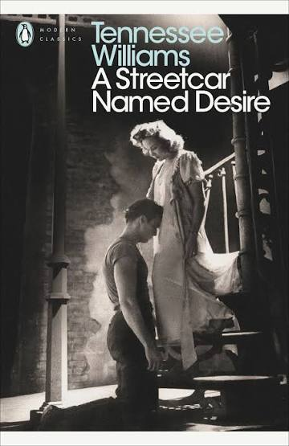



Set Texts Reading List Y12
Term 1 – Paper 1 Drama | Term 2 Paper 2 – Prose | Term 3 – Coursework
Othello – Shakespeare | The Handmaid’s Tale – Margaret Atwood | Cat on a Hot Tin Roof – Tennessee Williams
A Streetcar Named Desire – Tennessee Williams | Frankenstein – Mary Shelley | The Great Gatsby – F Scott Fitzgerald or The Color Purple – Alice Walker

Slide 3

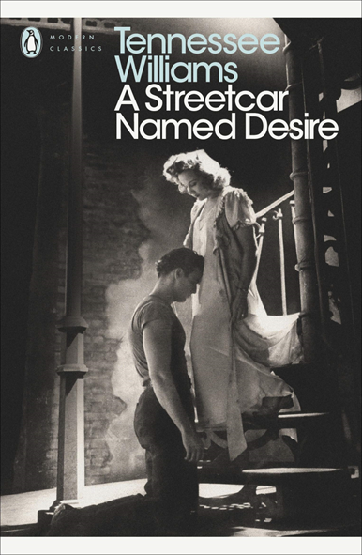
Text | Description | Link
Othello | This link will take you to a really interesting discussion about the use of blackface by white actors playing Othello. It explores the extent to which the play can be said to be racist, and how attitudes have changed over time. | https://soundcloud.com/folgershakespearelibrary
 | Not just the Tudors - a range of podcasts on Elizabethan and Tudor history | https://www.bbc.co.uk/sounds/brand/p0k5s6b4?page=1
 | Audio version of the play | https://www.bbc.co.uk/sounds/play/m000hgqz
 | Actor Hugh Quarshie reflects on playing the role in 2015. | https://www.bbc.co.uk/iplayer/episode/m001rrzf/remembers-hugh-quarshie-remembers-othello
 | Shakespeare in Context | https://www.bbc.co.uk/iplayer/episodes/p00qhwll/simon-schamas-shakespeare https://www.bbc.co.uk/sounds/play/b078xpf2
 | Shakespeare – Biography Rise of a Genius | https://www.bbc.co.uk/iplayer/episodes/p0gjkv0t/shakespeare-rise-of-a-genius
Streetcar | Interviews with the BBC _ from the archive | Witness History - Tennessee Williams on the BBC - BBC Sounds
 | Biography – Great Lives | https://www.bbc.co.uk/sounds/play/b00p8dkb
 | Listen to an audio version of the play | https://www.youtube.com/watch?v=FoVH6S4foT4

Slide 4


Text | Description | Link
Frankenstein | Podcast looking at how Frankenstein came to be. | https://www.bbc.co.uk/sounds/play/m00051n6
 | Context – the writing of Frankenstein | https://www.bbc.co.uk/iplayer/episode/p025zldt/the-secret-life-of-books-series-1-2-frankenstein
 | The sublime | https://www.bbc.co.uk/programmes/p004y23j
 | Context | https://www.bbc.co.uk/iplayer/episode/p027w85f/the-strange-affair-of-frankenstein
 | The Audiobook | https://www.bbc.co.uk/sounds/series/p07lbwfw https://thisiscriminal.com/mystery/
The Handmaid’s Tale | Elisabeth Moss reading the text | https://www.youtube.com/watch?v=0pmWf1k-vFM
 | Interview with Margaret Atwood | https://www.bbc.co.uk/iplayer/episode/m0008lhp/when-mary-beard-met-margaret-atwood
 | Context – Thatcher and Reagan | https://www.bbc.co.uk/iplayer/episodes/m00165jb/thatcher-reagan-a-very-special-relationship

