Slide 1
Snack Shack Holiday Project Guide
You will make a snack shop App using Python
Step-by-step instructions for festive snack creations
Notes:
---

Slide 2
Introduction to Snack Shack Project
Notes:
What is Snack Shack?, Why this project matters

Slide 3
What is Snack Shack?
Beginner-Friendly Python Project
Snack Shack is designed for beginners to learn Python through a practical shop system project.
Core Programming Concepts
Students learn variables, loops, conditionals, functions, arrays, and file handling in this project.
Hands-On Learning Experience
The project offers practical experience and builds confidence by creating a functional program.
Notes:
Snack Shack is a beginner-friendly Python project designed for OCR J277 GCSE Computer Science students. The goal is to create a simple shop system where users can browse items, add them to a basket, checkout, and save or load orders. This project helps students learn programming fundamentals, data types, and additional programming techniques in a practical and engaging way. It covers variables, loops, if statements, functions, arrays, file handling, and even a basic SQL-like search feature. By completing this project, students will gain hands-on experience with core programming concepts while building a functional program they can be proud of.

Slide 4

Why this project matters
Programming Fundamentals
  The project covers key programming concepts including variables, inputs/outputs, sequence, selection, and iteration.
Data Types and Casting
  Students learn about various data types such as integer, real, Boolean, character, and string, including data casting techniques.
Advanced Programming Techniques
  The project reinforces concepts like arrays, records, subprograms, string manipulation, file handling, SQL, and use of random numbers.
Skills for Success
  This project boosts problem-solving, logical thinking, and modular programming essential for computer science success.
Notes:
Snack Shack aligns with OCR J277 specification topics: 2.2.1 Programming Fundamentals (variables, inputs/outputs, sequence, selection, iteration), 2.2.2 Data Types (integer, real, Boolean, character, string, casting), and 2.2.3 Additional Programming Techniques (arrays, records, subprograms, string manipulation, file handling, SQL, random numbers). Completing this project will reinforce these skills in a real-world context, making exam preparation easier and more meaningful. It also encourages problem-solving, logical thinking, and modular programming, which are essential for success in computer science.

Slide 5
Step-by-Step Instructions
Notes:
Step 1: Set Up Your Project, Step 2: Build the Main Menu, Step 3: Work with Data Types and Arrays, Step 4: Add Functions and String Manipulation, Step 5: File Handling and SQL Search

Slide 6

Step 1: Set Up Your Project
Project Folder Structure
  Create a top-level folder with specific Python files and a data folder to organize your project.
Modular File Roles
  Each file has distinct responsibilities, promoting modular programming and better code organization.
Environment Setup
  Ensure Python 3 is installed and use an IDE like IDLE or online platforms to write and test code.
Notes:
Create a folder named 'snack_shack'. Inside it, make these files: app.py (main menu), data.py (items and prices), shop.py (functions for basket and checkout), files.py (save/load orders), search_sql.py (simple SQL-like search), and tests.py (basic tests). Also create a 'data' folder with inventory.csv and orders.txt. This structure helps you organize your code and practice modular programming. Ensure Python 3 is installed on your computer. You can use IDLE or an online IDE like Replit if you prefer.

Slide 7

Step 2: Build the Main Menu
Menu Looping Structure
  A while loop repeatedly displays the menu until the user selects to quit the application.
Menu Options
  Menu includes options like View items, Add to basket, View basket, Checkout, and Search items to interact with the app.
Conditional Logic Handling
  If/elif/else statements manage user choices and execute corresponding actions in the app.
Programming Constructs
  This step demonstrates key programming concepts: sequence, selection, and iteration.
Notes:
In app.py, create a loop that displays a menu with options: View items, Add to basket, View basket, Checkout, Save order, Load order, Search items, and Quit. Use a while loop to keep showing the menu until the user chooses Quit. Use if/elif/else statements to handle each choice. This step teaches sequence, selection, and iteration, which are key programming constructs.

Slide 8
Step 3: Work with Data Types and Arrays
Using Multiple Data Types
Lists of dictionaries store data with varied types including string, float, integer, boolean, and character.
List of Dictionaries Structure
A list holds dictionaries, each representing an item with specific attributes and data types.
Type Casting Practice
Converting input strings to integers or floats using int() and float() functions for accurate data handling.
Notes:
In data.py, create a list of dictionaries to store items. Each dictionary should have keys like name (string), price (float), stock (integer), onSale (Boolean), and code (character). This demonstrates how to use different data types and records. You will also practice casting by converting input strings to integers or floats using int() and float().

Slide 9
Step 4: Add Functions and String Manipulation
Modular Functions
Functions like show_items(), add_to_basket(), and checkout() organize code into reusable blocks, improving maintainability.
String Manipulation Methods
Use string methods such as .upper(), .strip(), and slicing to clean user input and handle offer codes effectively.
Notes:
In shop.py, write functions such as show_items(), add_to_basket(), and checkout(). Functions make your code modular and easier to maintain. Use string methods like .upper(), .strip(), and slicing to clean user input and apply offer codes. This step covers subprograms and string manipulation from the specification.

Slide 10
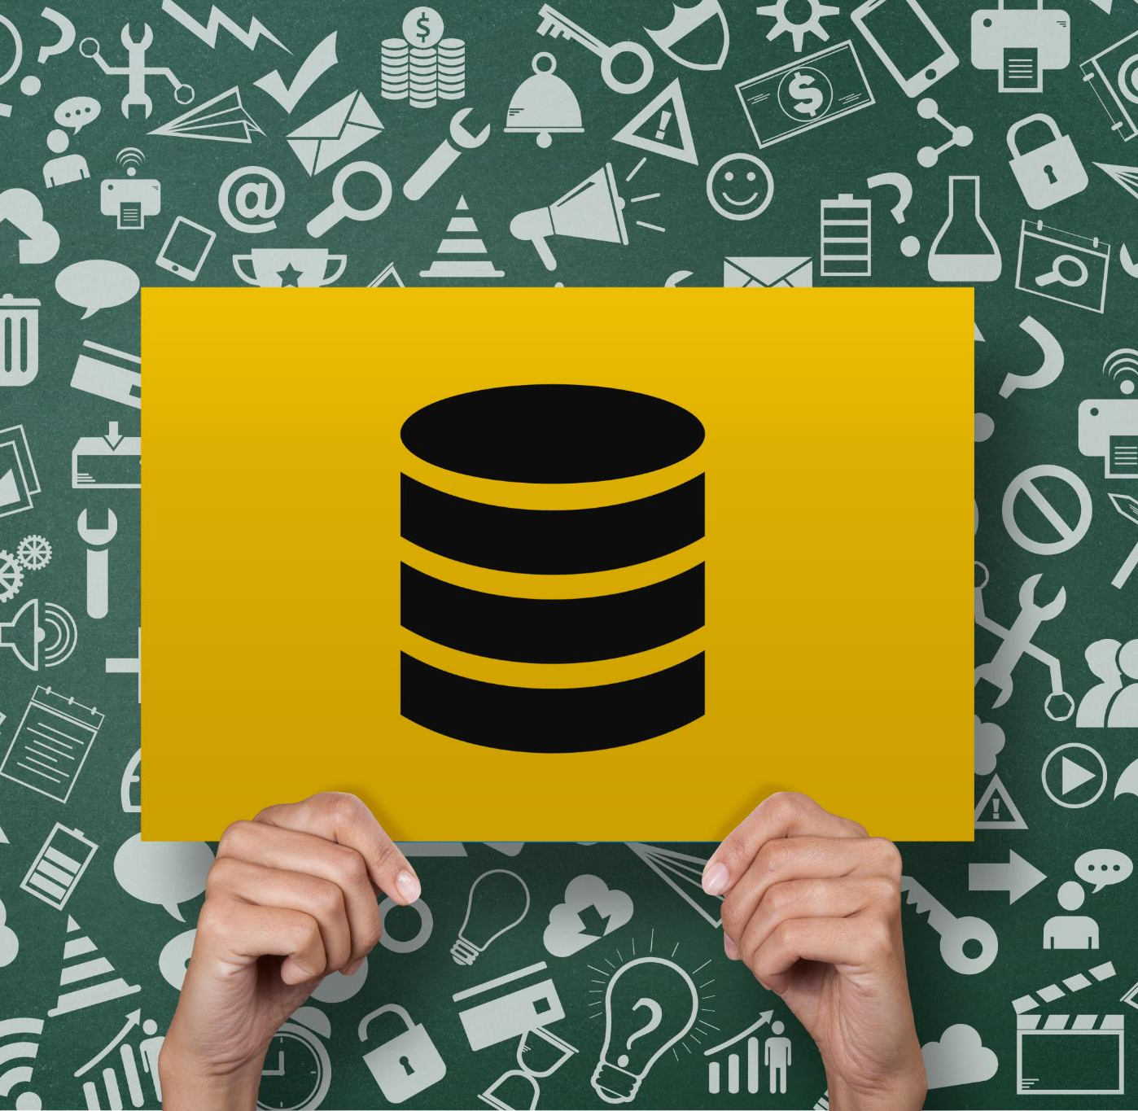
Step 5: File Handling and SQL Search
File Saving and Loading
  Implement saving and loading of order data using Python file operations like open(), read(), write(), and close().
Safe File Operations
  Use 'with open' context manager to ensure safe and automatic closing of files during read/write tasks.
Simplified SQL Search
  Create a feature to let users type simple SQL-like queries to filter items safely and effectively.
Notes:
In files.py, implement saving and loading orders using open(), read(), write(), and close() (or with open for safety). In search_sql.py, create a simple feature that lets users type queries like SELECT name WHERE price < 1.50 to filter items. This models SQL searching in a safe, simplified way. These tasks meet the additional programming techniques requirement.

Slide 11
YouTube Support and Resources
Notes:
Helpful Videos

Slide 12

Helpful Videos
Loops and Iteration
  Beginner-friendly videos explain loops and iteration concepts clearly and step by step.
Conditional Statements
  Videos cover if statements to help beginners understand decision-making in programming.
Data Types and Casting
  Educational content explains data types and how to convert or cast between them effectively.
Subprograms and Techniques
  Videos introduce subprograms and additional programming techniques suitable for beginners.
Notes:
Students can watch these beginner-friendly videos:
- Loops and iteration: Corey Schafer (https://www.youtube.com/watch?v=6iF8Xb7Z3wQ)
- If statements: Alex The Analyst (https://www.youtube.com/watch?v=f4KOjWS_KZs)
- Data types and casting: CSNewbs (https://www.youtube.com/watch?v=EOwTklQI1Q4)
- Subprograms and additional techniques: CSNewbs (https://www.csnewbs.com/ocr2020-2-3-additionaltechniques)
These videos explain the concepts step by step and are suitable for beginners.

Slide 13
Checklist and Stretch Goals
Notes:
Beginner Checklist, Stretch Goals for Advanced Students

Slide 14
Beginner Checklist
Project Setup
  Created project folder and files to organize the coding work effectively.
Menu Programming
  Built main menu using loops and if statements for user interaction.
Variable Usage
  Used variables with correct data types to store and manage data efficiently.
Basket and Calculations
  Added items to a basket and calculated totals to simulate shopping functionality.
File Operations
  Saved and loaded orders from a file to maintain data persistence.
Functions and Strings
  Wrote functions and used string methods to modularize code and manipulate text.
Code Testing
  Tested code using tests.py to ensure functionality and correctness.
Notes:
✔ I created the project folder and files.
✔ I built the main menu with a loop and if statements.
✔ I used variables and correct data types.
✔ I added items to a basket and calculated totals.
✔ I saved and loaded orders from a file.
✔ I wrote at least one function and used string methods.
✔ I tested my code using tests.py.

Slide 15

Stretch Goals for Advanced Students
2D Arrays for Data Tracking
  Use two-dimensional arrays to manage and analyze weekly sales data effectively.
Random Discounts Implementation
  Incorporate random number generation to apply dynamic discounts in sales calculations.
Advanced SQL Parsing
  Enhance SQL parsing ability to handle complex AND/OR conditional statements.
Input Validation and Testing
  Validate user inputs using loops and write multiple unit tests for function reliability.
Notes:
For students who want a challenge:
- Add a 2D array to track weekly sales.
- Implement random discounts using random.randint().
- Extend the SQL parser to support AND/OR conditions.
- Validate user input with loops.
- Write 8–12 unit tests for your functions.

Slide 16
Marking and Specification Links
Notes:
Marking Guide

Slide 17
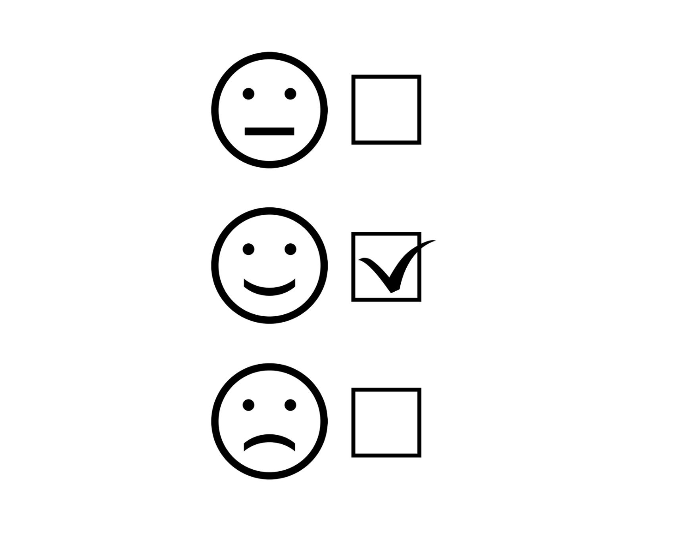
Marking Guide
Programming Fundamentals
  Fundamentals include menus, loops, and if statements, contributing 12 marks to the total score.
Data Types and Casting
  Understanding data types and casting techniques is worth 8 marks in the marking guide.
Additional Techniques
  Includes arrays, functions, file handling, SQL, and string manipulation, totaling 14 marks.
Testing and Documentation
  Testing and documentation contribute 6 marks, emphasizing code quality and clarity.
Notes:
Total: 40 marks
- Programming fundamentals (menu, loops, if statements): 12 marks
- Data types and casting: 8 marks
- Additional techniques (arrays, functions, file handling, SQL, string manipulation): 14 marks
- Testing and documentation: 6 marks
This aligns with OCR J277 sections 2.2.1, 2.2.2, and 2.2.3.

